Slide 1
ShanghaiTech University
EE 115B: Digital Circuits
Fall 2024
Lecture 15
Hengzhao Yang
December 3, 2024

Slide 2
D flip-flops
Operation
  Output follows input at active clock edge
Implementations
  Master-slave D flip-flop
    Output changes at negative edge of clock
    Output changes at positive edge of clock
  Edge-triggered D flip-flop
    Positive-edge-triggered
    Negative-edge-triggered

Slide 3
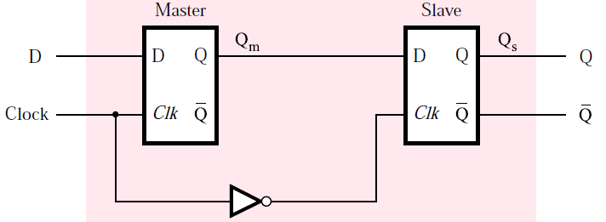
Master-slave D flip-flop: negative edge
Master-slave D flip-flop: negative edge
  Built on 2 gated D latches: master and slave
  Clock: original for master and complement for slave
  Output changes at negative edge of clock

Slide 4
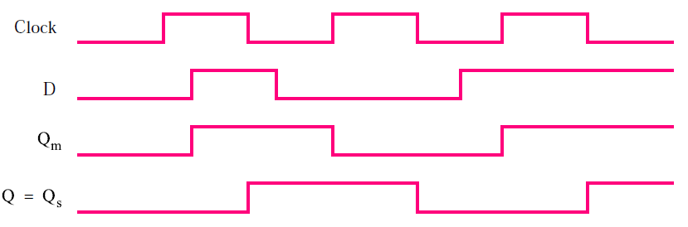
Master-slave D flip-flop: negative edge
Operation and timing diagram
  While Clock=1
    Master is active
    Q_{m} follows D
    Q_{s} remains unchanged
  While Clock=0
    Slave is active
    Q_{s} responds to Q_{m}, Q (final output) changes at negative edge

Slide 5
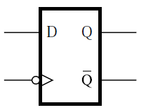
Master-slave D flip-flop: negative edge
Circuit symbol
  Symbol “>” denotes active edge of clock
  Bubble on clock indicates negative edge

Slide 6
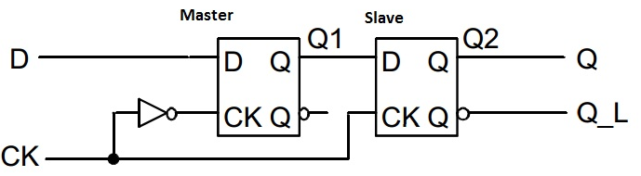
Master-slave D flip-flop: positive edge
Master-slave D flip-flop: positive edge
  Built on 2 gated D latches: master and slave
  Clock: complement for master and original for slave
  Output changes at positive edge of clock
Source: https://allthingsvlsi.files.wordpress.com/2013/04/master-slave-dff.jpg

Slide 7
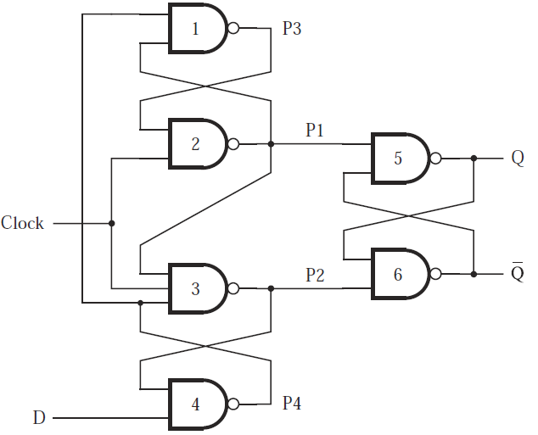
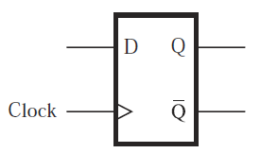
Edge-triggered D flip-flop: positive
Circuit and circuit symbol

Slide 8
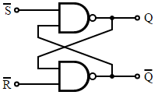
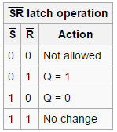
Edge-triggered D flip-flop: positive
Clock=0
  P1=1, P2=1, basic S’R’ latch holds
  P4=D’, P3=D
Positive edge
  P1=(P3 AND Clock)’=D’
  P2=(P1 AND Clock AND P4)’=D
  Q=P1’=D, Q’=P2’=D’ (latch: S’=P1, R’=P2)

Slide 9
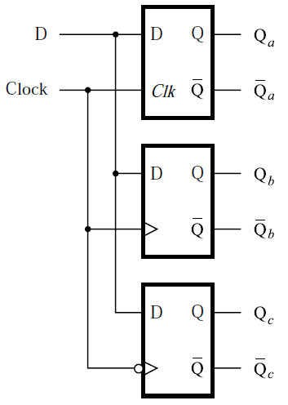
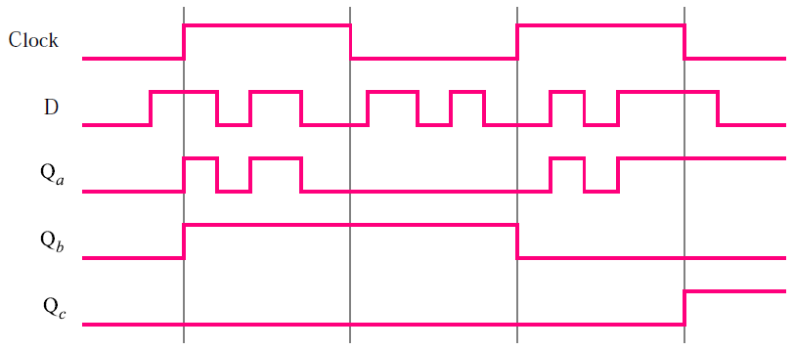
D: latch vs. flip-flop
Top to bottom
  Gated D latch (level sensitive)
  Positive-edge-triggered flip-flop
  Negative-edge-triggered flip-flop

Slide 10
D flip-flops with CLEAR and PRESET
Control signals: CLEAR and PRESET
  Use CLEAR to set initial condition Q=0
  Use PRESET to set initial condition Q=1
Implementations
  Based on master-slave D flip-flop
  Based on edge-triggered D flip-flop

Slide 11
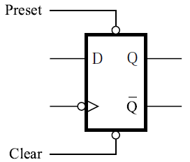
Master-slave D flip-flop with CLEAR and PRESET
CLEAR and PRESET are active low
  CLEAR=0: Q=0
  PRESET=0: Q=1
  CLEAR=1 or PRESET=1: no effect
Circuit symbol (negative edge)

Slide 12
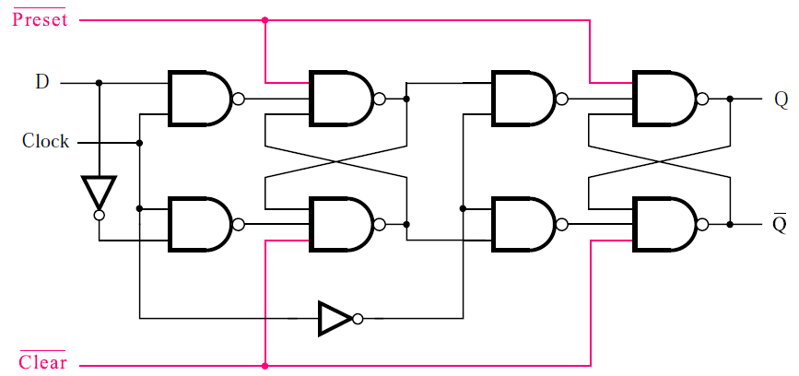
Master-slave D flip-flop with CLEAR and PRESET
Circuit: modified master-slave D flip-flop

Slide 13
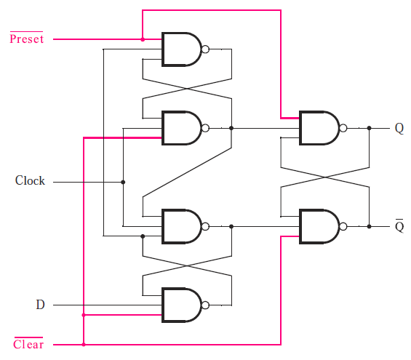
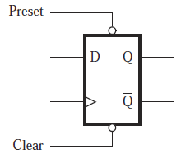
Edge-triggered D flip-flop with CLEAR and PRESET
Circuit and circuit symbol (positive edge)

Slide 14
Asynchronous vs. synchronous CLEAR
Asynchronous CLEAR
  If CLEAR=0, flip-flop will be cleared to Q=0 immediately without regard to clock
Synchronous CLEAR
  If CLEAR=0, flip-flop will be cleared to Q=0 at the next clock edge (positive or negative)

Slide 15
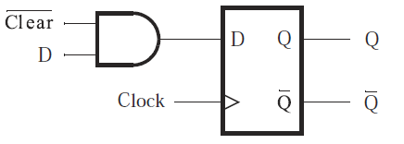
Synchronous CLEAR
Circuit

Slide 16
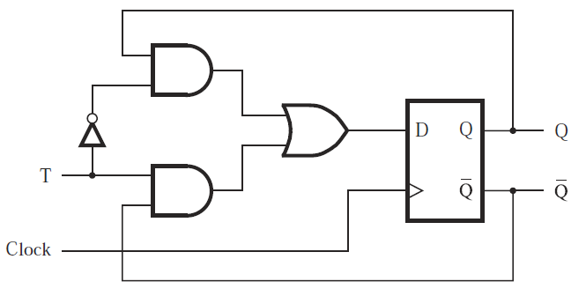
T flip-flop
T flip-flop
  T=0: state does not change
  T=1: state is reversed
Circuit

Slide 17
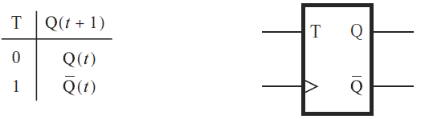
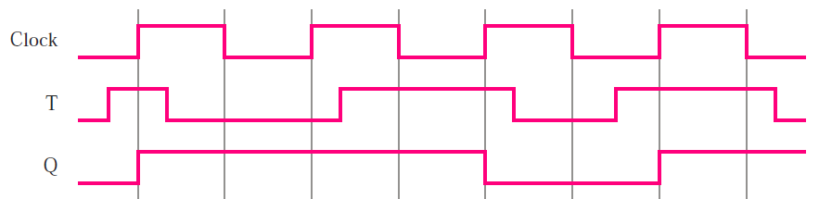
T flip-flop
Characteristic table and circuit symbol
Timing diagram

Slide 18
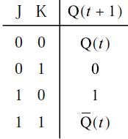
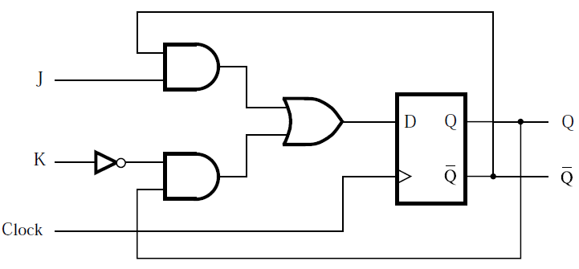
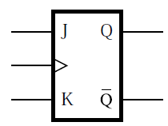
JK flip-flop
JK flip-flop
  Combines behaviors of basic SR latch and T flip-flop
  J: set, K: reset
Circuit, characteristic table, and circuit symbol

Slide 19
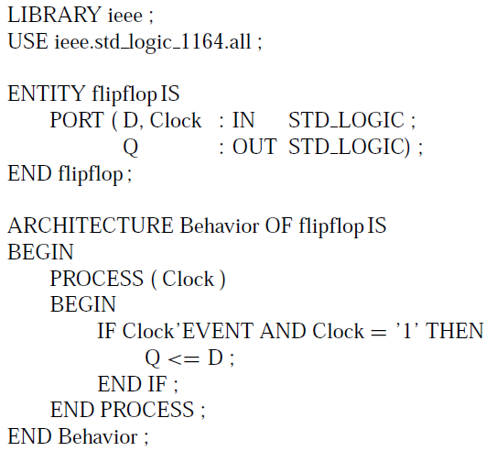
Code for D flip-flop (positive edge)
Code
  Sensitivity list: Clock
  ’EVENT: signal attribute
  Clock’EVENT: any change in the Clock signal
  Clock’EVENT AND Clock=‘1’: clock signal value has changed and the value is now 1 (positive edge)

Slide 20
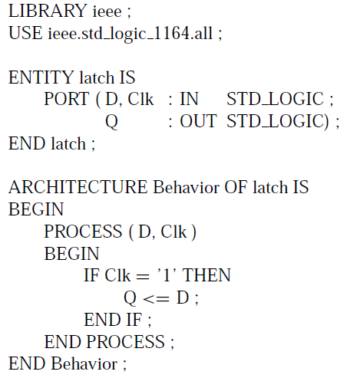
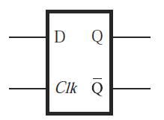
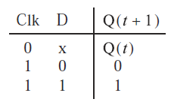
Comparison: VHDL code for gated D latch

